Slide 1
Chapter – 1 Basic Concepts and Preliminaries

Slide 2
Outline of Chapter
The Quality Revolution
Software Quality
Role of Testing
Verification and Validation
Failure, Error, Fault and Defect
The Notion of Software Reliability
The Objectives of Testing
Testing Activities
Testing Level
White-box and Black-box Testing
Test Planning and Design
Monitoring and Measuring Test Execution
Test Tools and Automation
Test Team Organization and Management

Slide 3
How to measure quality?

Slide 4
FOCUS of QUALITY process
Paying much attention to customer’s requirements
Making efforts to continuously improve quality
Integrating measurement processes with product design and development
Pushing the quality concept down to the lowest level of the organization
Developing a system-level perspective with an emphasis on methodology and process
Eliminating waste through continuous improvement
Adhering to deadlines

Slide 5
The Quality Revolution
Started in Japan by Deming, Juran, and Ishikawa during 1940s
In 1950s, Deming introduced statistical quality control to Japanese engineers
Statistical quality control (SQC) is a discipline based on measurement and statistics
SQC methods use seven basic quality management tool
Pareto analysis, Trend Chart, Flow chart, Histogram, Scatter diagram, Control chart, Cause and effect diagram
“Lean principle” was developed by Taiichi Ohno of Toyota
“A systematic approach to identifying and eliminating waste through continuous improvement, flowing the product at the pull of the customer in pursuit of perfection.”

Slide 6
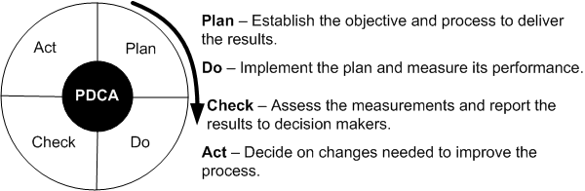
The Quality Revolution
Figure 1: The Shewhart cycle
Deming introduced Shewhart’s PDCA cycle to Japanese researchers
It illustrates the activity sequence:
Setting goals
Assigning them to measurable milestones
Assessing the progress against the milestones
Take action to improve the process in the next cycle

Slide 7
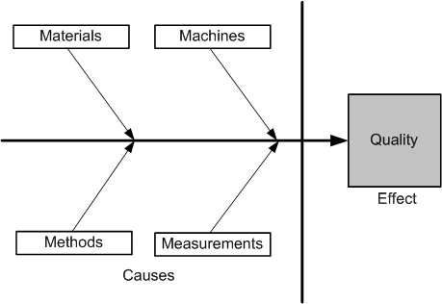
The Quality Revolution
In 1954, Juran spurred the move from SQC to TQC (Total Quality Control)
Key Elements of TQC:
Quality comes first, not short-term profits
The customer comes first, not the producer
Decisions are based on facts and data
Management is participatory and respectful of all employees
Management is driven by cross-functional committees
An innovative methodology developed by Ishikawa called cause-and-effect diagram
Figure 2: Ishikawa diagram

Slide 8
Ishikawa diagram
Kaoru Ishikawa found from statistical data that dispersion in product quality came from four common causes, namely materials, machines, methods, and measurements, known as the 4 Ms.
Materials often differ when sources of supply or size requirements vary.
Machines, or equipment, also function differently depending on variations in their parts, and they operate optimally for only part of the time.
Methods, or processes, cause even greater variations due to lack of training and poor handwritten instructions.
Finally, measurements also vary due to outdated equipment and improper calibration.
Variations in the 4 Ms parameters have an effect on the quality of a product.
Figure 2: Ishikawa diagram

Slide 9
Ishikawa diagram
An Ishikawa diagram, also known as a fishbone diagram or cause-and-effect diagram, is a valuable tool for identifying and analyzing the potential causes of quality issues in a software product.
Example Categories for Software Quality Issues:
People: Skill levels, training, communication, workload.
Processes: Development methodologies, testing procedures, code reviews.
Tools: Development environments, testing tools, version control systems.
Environment: Work conditions, hardware, network infrastructure.
By using an Ishikawa diagram, software development teams can systematically approach quality issues, identify the root causes, and implement effective solutions to improve the overall quality of their software products.

Slide 10
Software Quality
Five Views of Software Quality:
Transcendental view
It envisages quality as something that can be recognized but is difficult to define.
I know it when I see it.
User’s view
Does the product satisfy user needs and expectations?
Manufacturing view
Quality is understood as conformance to the specification.
The quality level of a product is determined by the extent to which the product meets its specifications.
Product view
Quality is viewed as tied to the inherent characteristics of the product. A product’s inherent characteristics, that is, internal qualities, determine its external qualities.
Value-based view
Depends on the amount a customer is willing to pay for it.

Slide 11
Software Quality
Software quality in terms of quality factors and criteria
A quality factor represents a behavioural characteristic of a system
Examples: correctness, reliability, efficiency, and testability
A quality criterion is an attribute of a quality factor that is related to software development
Example: modularity is an attribute of software architecture
Quality Models
Examples: ISO 9126, CMM, TPI, and TMM

Slide 12
Role of Testing
Software quality assessment divide into two categories:
Static analysis
It examines the code and reasons overall behavior that might arise during run time
Identify issues within the logic and techniques
Examples: Code review, inspection, and algorithm analysis
Dynamic analysis
Actual program execution to expose possible program failure
Involves running code and examining the outcome, which also entails testing possible execution paths of the code.
Static and Dynamic Analysis are complementary in nature
Focus is to combine the strengths of both approaches

Slide 13
Verification and Validation
Verification
Evaluation of software system that helps in determining whether the product of a given development phase satisfies the requirements established before the start of that phase
Building the product correctly
Are we building the product right?
It is static testing
It includes checking documents, design, codes and programs.
Validation
Evaluation of software system that helps in determining whether the product meets its intended use
Building the correct product
Are we building the right product?
It is dynamic testing
It includes testing and validating the actual product i.e. it includes execution of the code.

Slide 14
Failure, Error, Fault and Defect
Failure
A failure is said to occur whenever the external behavior of a system does not conform to that prescribed in the system specification
Error
An error is a state of the system.
An error state could lead to a failure in the absence of any corrective action by the system
Fault
A fault is the adjudged cause of an error
Defect
It is synonymous of fault
It a.k.a. bug
The process of failure manifestation can therefore be succinctly represented as a behavior chain as follows: fault → error → failure.

Slide 15
The Notion of Software Reliability
Software reliability refers to the probability of a software system or component functioning correctly under specified conditions for a specified period of time.
It is a critical aspect of software quality, reflecting the system's ability to perform its required functions without failure.
It is defined as the probability of failure-free operation of a software system for a specified time in a specified environment
The level of reliability of a system depends on those inputs that cause failures to be observed by the end users.
Measured using metrics: Mean Time Between Failures (MTBF), Mean Time to Repair (MTTR), Defect Density

Slide 16
The Objectives of Testing
It does work
To find what is working [can be a single unit, integration of units or entire system]
It does not work
To find what is not working
Reduce the risk of failures
Complex system fail from time to time and gives rise to a notion of failure rate
Reduce the cost of testing
the cost of designing, maintaining, and executing test cases,
the cost of analyzing the result of executing each test case,
the cost of documenting the test cases, and
the cost of actually executing the system and documenting it.

Slide 17
What is a Test Case?
Test Case is a simple pair of
<input, expected outcome>
State-less systems: A compiler is a stateless system
Test cases are very simple
A compiler is a stateless system because to compile a program it does not need to know about the programs it compiled previously
Outcome depends solely on the current input
State-oriented: ATM is a state-oriented system
Test cases are not that simple. A test case may consist of a sequences of <input, expected outcome>
The outcome depends both on the current state of the system and the current input
ATM example:
< check balance, $500.00 >,
< withdraw, “amount?” >,
< $200.00, “$200.00” >,
< check balance, $300.00 >

Slide 18
Expected Outcome
An outcome of program execution may include
Value produced by the program
State Change
A sequence of values which must be interpreted together for the outcome to be valid
A test oracle is a mechanism that verifies the correctness of program outputs
Generate expected results for the test inputs
Compare the expected results with the actual results of execution of the IUT

Slide 19
The Concept of Complete Testing
Complete or exhaustive testing means
“There are no undisclosed faults at the end of the test phase”
Complete testing is nearly impossible for most of the system
The domain of possible inputs of a program is too large
Valid inputs
Invalid inputs
The design issues may be too complex to completely test
It may not be possible to create all possible execution environments of the system

Slide 20
The Central Issue in Testing
Figure 3: A subset of the input domain exercising a subset of the program behavior
Divide the input domain D into D1 and D2
Select a subset D1 of D to test program P
It is possible that D1 exercise only a part P1 of P

Slide 21
Testing Activities
Identify the objective to be tested
Select inputs
Compute the expected outcome
Set up the execution environment of the program
Execute the program
Analyze the test results
Figure 4: Different activities in process testing

Slide 22
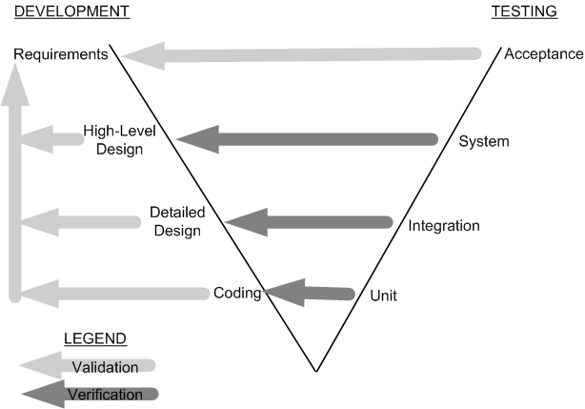
Testing Level
Unit testing
Individual program units, such as procedure, methods in isolation
Integration testing
Modules are assembled to construct larger subsystem and tested
System testing
Includes wide spectrum of testing such as functionality, and load
Acceptance testing
Customer’s expectations from the system
Two types of acceptance testing
User Acceptance Test (UAT)
Business Acceptance Test (BAT)
UAT: System satisfies the contractual acceptance criteria
BAT: System will eventually pass the user acceptance test
Figure 5: Development and testing phases in the V model

Slide 23
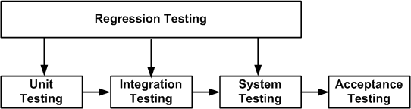
Testing Level
Figure 6: Regression testing at different software testing levels
New test cases are not designed
Test are selected, prioritized and executed
To ensure that nothing is broken in the new version of the software

Slide 24
Source of Information for Test Selection
Requirement and Functional Specifications
Source Code
Input and output Domain
Operational Profile
Fault Model
Error Guessing
Fault Seeding
Mutation Analysis

Slide 25
White-box and Black-box Testing
White-box testing a.k.a. structural testing
Examines source code with focus on:
Control flow
Data flow
Control flow refers to flow of control from one instruction to another
Data flow refers to propagation of values from one variable or constant to another variable
It is applied to individual units of a program
Software developers perform structural testing on the individual program units they write
Black-box testing a.k.a. functional testing
Examines the program that is accessible from outside
Applies the input to a program and observes the externally visible outcome
It is applied to both an entire program as well as to individual program units
It is performed at the external interface level of a system
It is conducted by a separate software quality assurance group

Slide 26
Test Planning and Design
The purpose is to get ready and organized for test execution
A test plan provides a:
Framework
A set of ideas, facts or circumstances within which the tests will be conducted
Scope
The domain or extent of the test activities
Details of resources needed
Effort required
Schedule of activities
Budget
Test objectives are identified from different sources
Each test case is designed as a combination of modular test components called test steps
Test steps are combined together to create more complex tests

Slide 27
Monitoring and Measuring Test Execution
Metrics for monitoring test execution
Metrics for monitoring defects
Test case effectiveness metrics
Measure the “defect revealing ability” of the test suite
Use the metric to improve the test design process
Test-effort effectiveness metrics
Number of defects found by the customers that were not found by the test engineers

Slide 28
Test Tools and Automation
Increased productivity of the testers
Better coverage of regression testing
Reduced durations of the testing phases
Reduced cost of software maintenance
Increased effectiveness of test cases
The test cases to be automated are well defined
Test tools and infrastructure are in place
The test automation professionals have prior successful experience in automation
Adequate budget have been allocation for the procurement of software tools

Slide 29
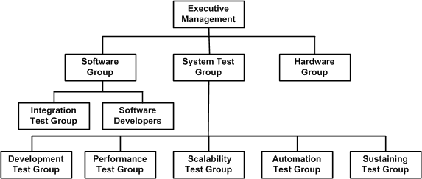
Test Team Organization and Management
Figure 7: Structure of test groups
Hiring and retaining test engineers is a challenging task
Interview is the primary mechanism for evaluating applicants
Interviewing is a skills that improves with practice
To retain test engineers management must recognize the importance of testing efforts at par with development effort

Slide 30
Thank You!!

